Slide 1
Law Enforcement Management System (LEMS)
Group A

Slide 2
What the System is doing?
1
3
2
4
SHO
Citizen
File a Complain
View the Complains Status
SHO reviews the complaint details and begins the investigation.
Assigns the Officers to Investigations including the leading Officer for the Investigations
SHO also assigns Patrolling to officers.
Either is a dispatch Patrol for reviewing the complain status or just regular Patrolling.
HR
Hires the officers
Username and Passwords are allocated
Salary according to the rank is allocated
Also in Charge of Promotion and Demotion
Administrative Staff
Administrative staff allocate vehicles and weapons to officers when assigned an investigation
Also allocates vehicles for Patrolling

Slide 3
7
5
6
Correctional Process
Investigation
Investigating officer gathers evidence and apprehends suspects.
Updates the complaint status to “Solved" upon successful resolution.
Correctional officers use the system to manage jail cells and assign criminals to appropriate facilities.
Assigned criminals are recorded within the system, along with their respective jail cell IDs.
Criminal Apprehension
Upon apprehending suspects, officers update the system with their details as criminals.

Slide 4

Tasks
Zunaira Abdul Aziz BSSE23058 Best Assistant
Fatima Noorulain BSSE23003 Best Leader
Eashal Yasin BSSE23026 Best Consultant
Cells
Bail
Vehicle
Forensic Lab
Police Station
Criminals
Crime (Different Crimes)
Officers (Correctional Officer, AssitantSuperIntendant)
Cells
Bail
Vehicle
Forensic Lab
Police Station
Criminals
Crime (Different Crimes)
Officers (Correctional Officer, AssitantSuperIntendant)
Budget (Allocation of Salaries, Vehicles and Equipment)
User (in charge of usernames and password safety)
Equipment (adding, viewing)
Administrative Staff (in charge of assigning Vehicles and Equipment to Investigations and Patrolling)
Officers (IP, ASI, SI)
SHO (sorting complains, starting investigations and assigning Patrolling)
Citizen ( filing a complain)
Complain
Forensic Expert (Handles evidence)
Patrolling
Investigation (creating evidences)
Officers ( Head Constable and Constable)
Shared Tasks
Fatima
Zunaira
HR (Zunaira and Fatima)
Forensic Lab (Eashal and Fatima)
User (Zunaira and Fatima)
Officers (All members)
SHO (Fatima and Zunaira)
AdministrativeStaff (Zunaira and Eashal)
Eashal

Slide 5
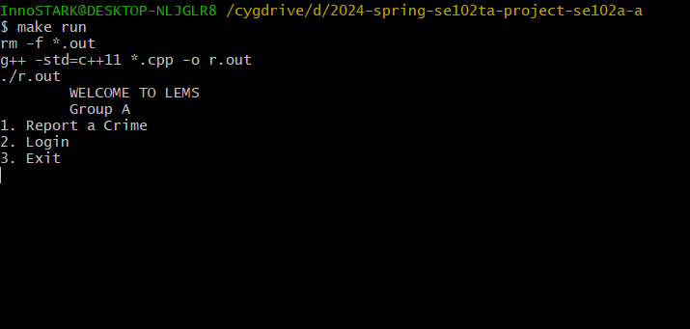
1
LEMS
Main Page
Username
Password
Login
Report a Crime

Slide 6
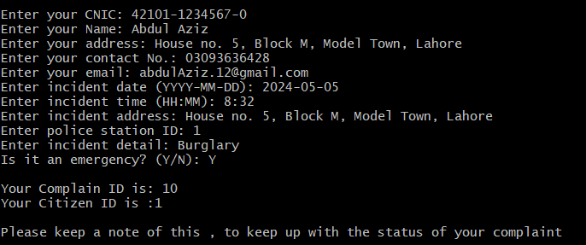
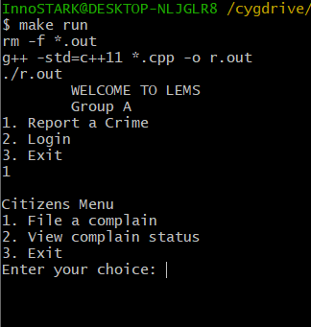
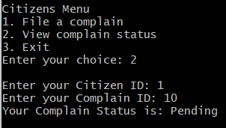
2
Report a Crime
File a Complain
View Complain Status
Exit

Slide 7
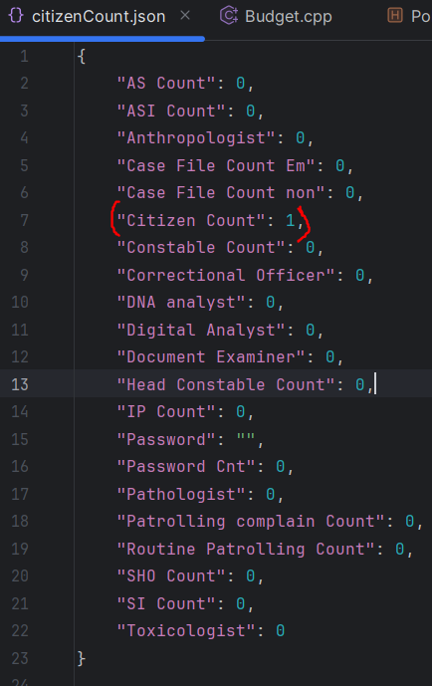
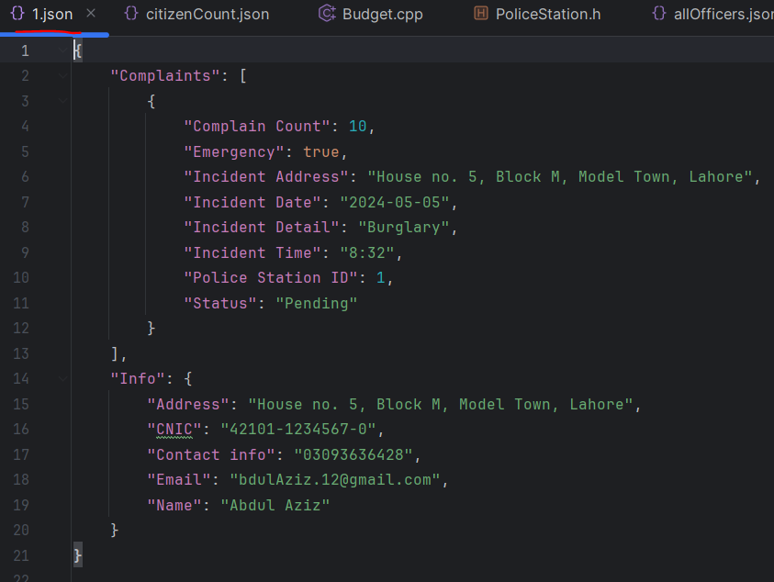

Slide 8
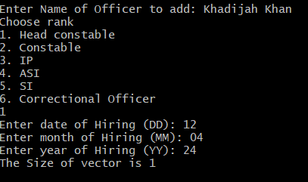
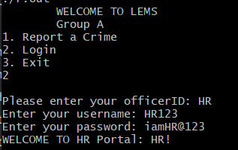
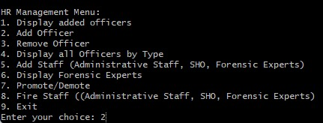
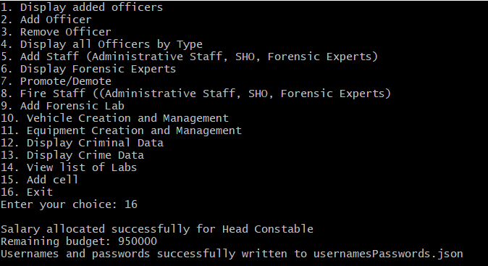
3
HR (Hiring Manager)

Slide 9
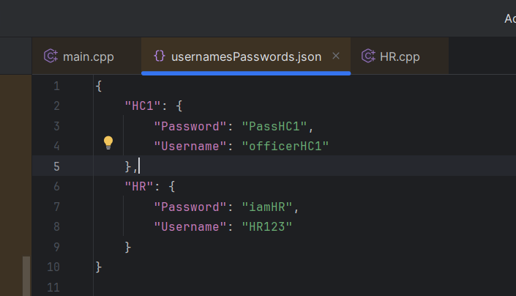
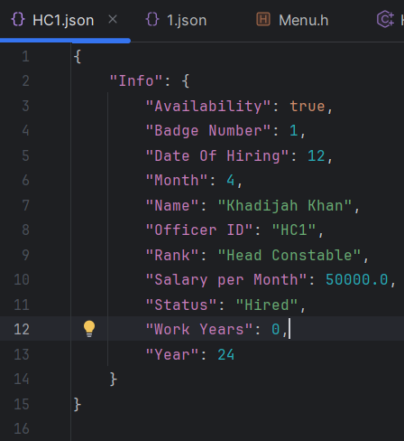
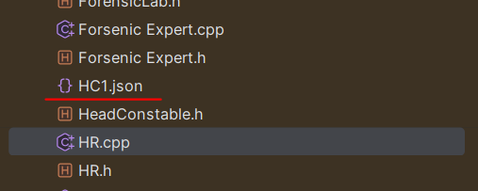

Slide 10
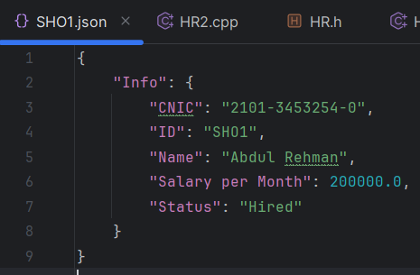
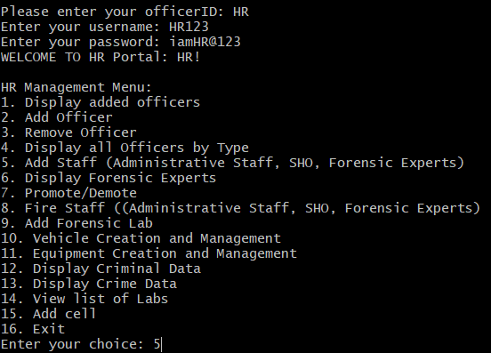
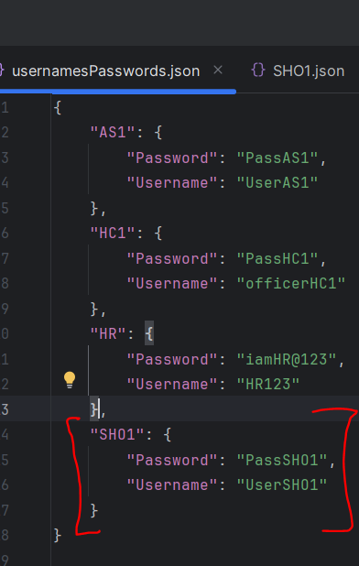
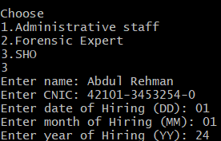
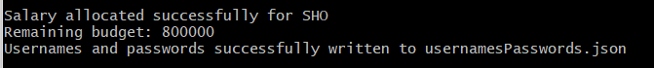
SHO added By HR

Slide 11
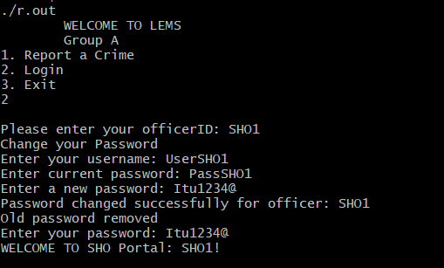
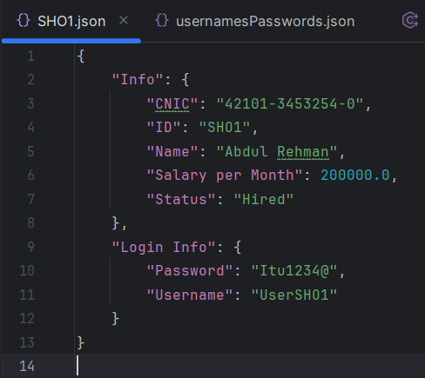
4
SHO

Slide 12
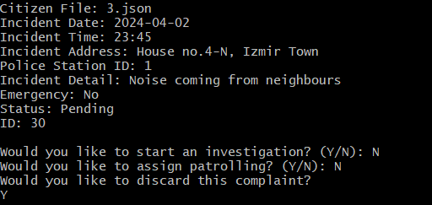
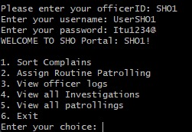
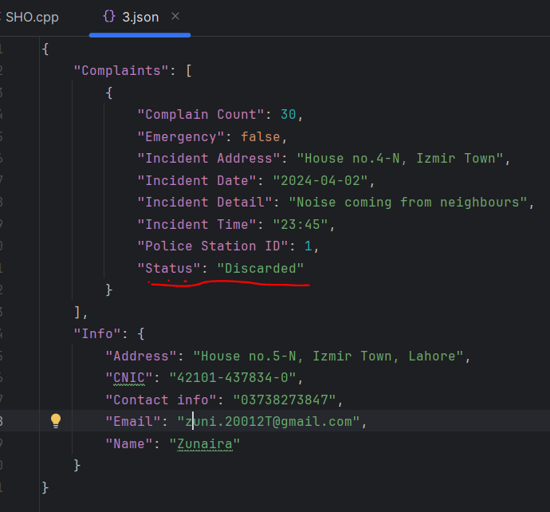
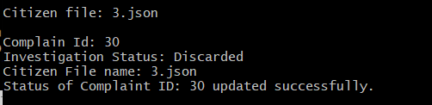
SHO
If No

Slide 13
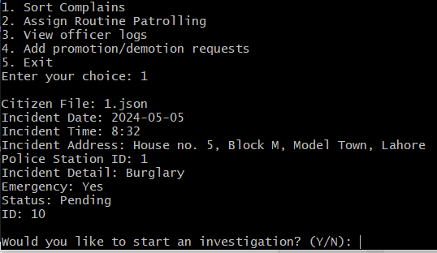
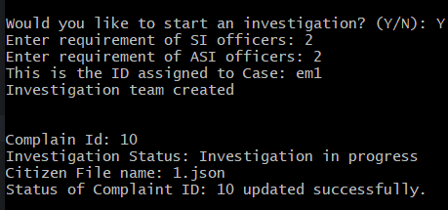
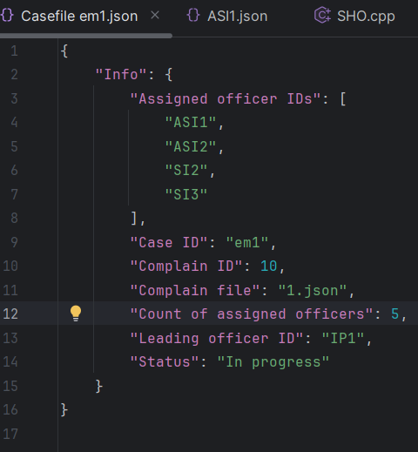
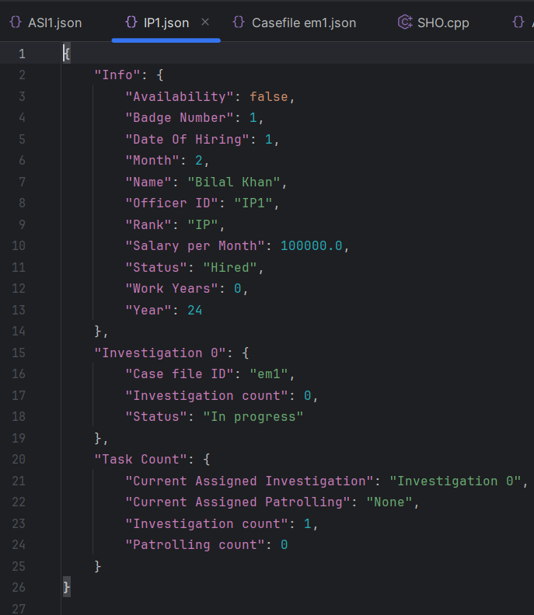
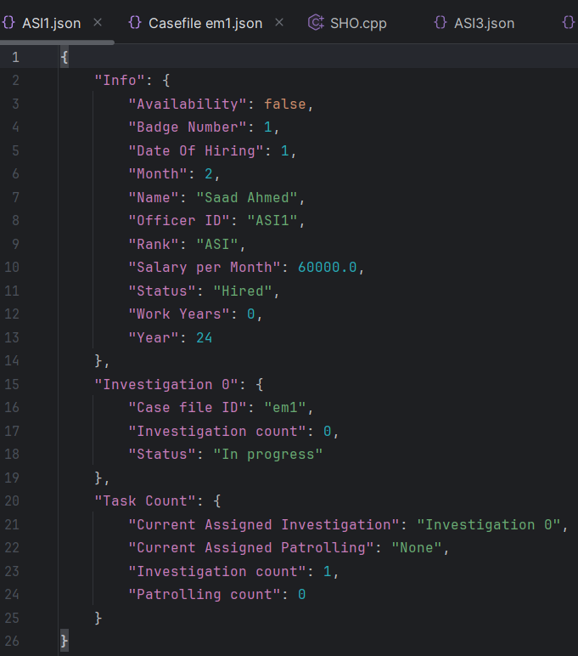
If yes and Emergency

Slide 14
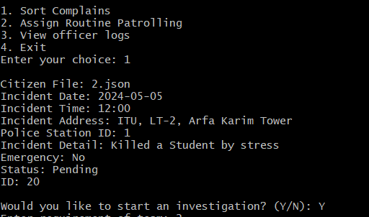
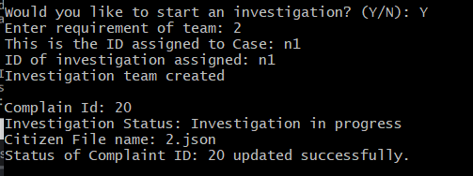
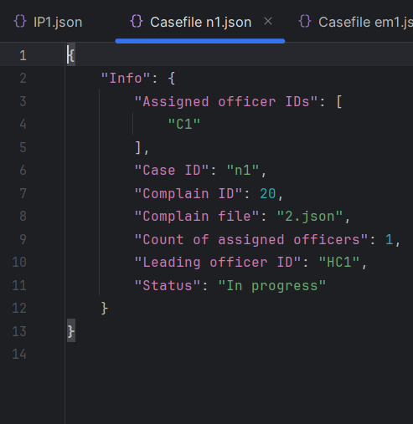
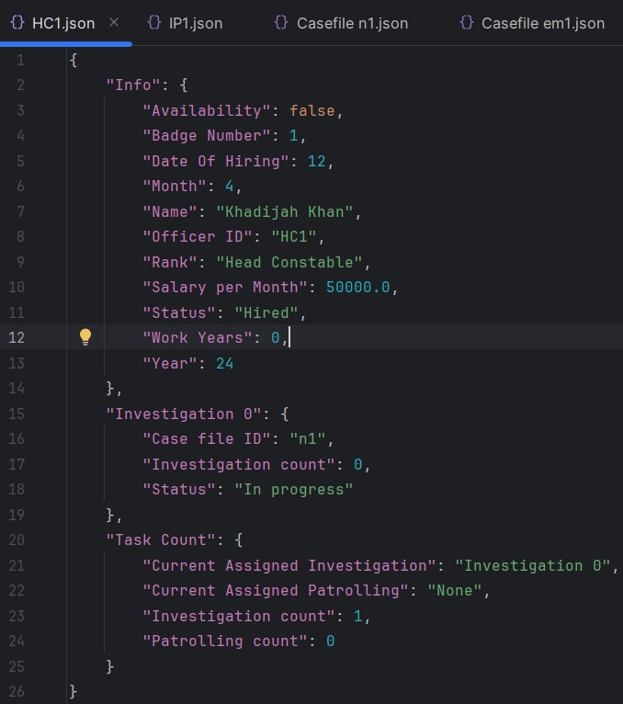
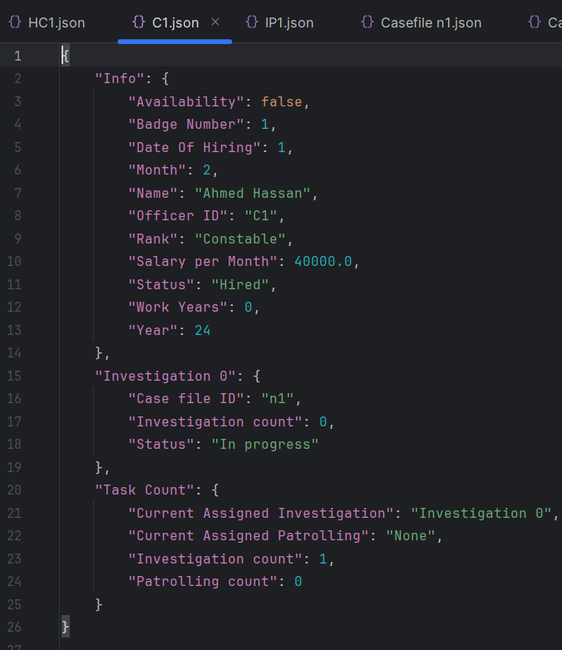
If yes and
Non- Emergency

Slide 15
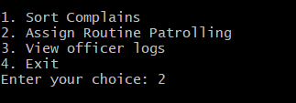
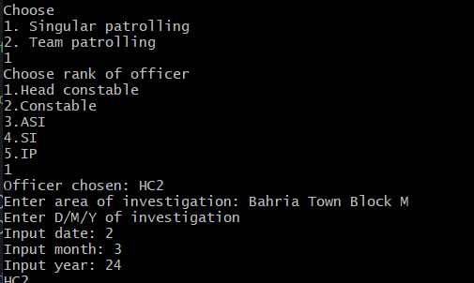
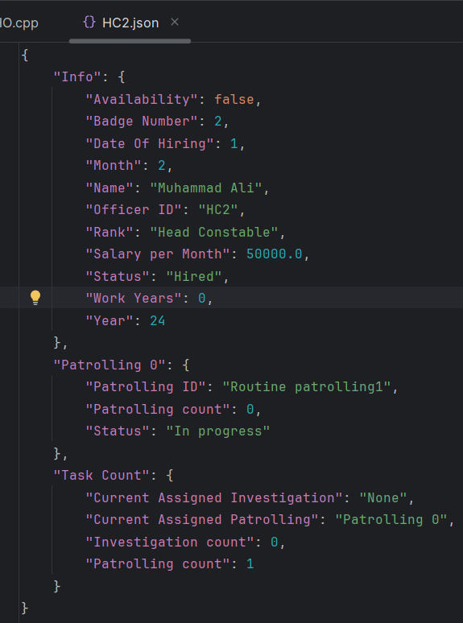
Patrolling

Slide 16
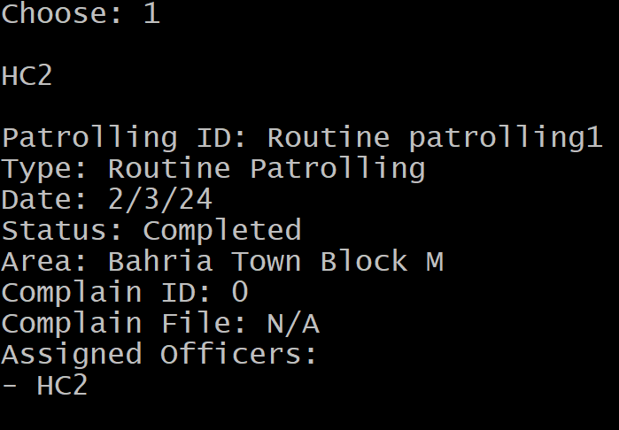
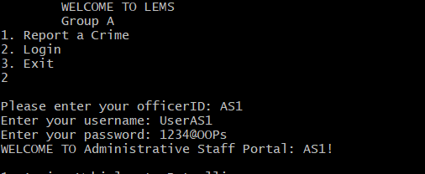
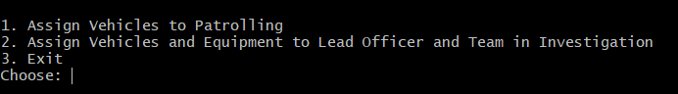
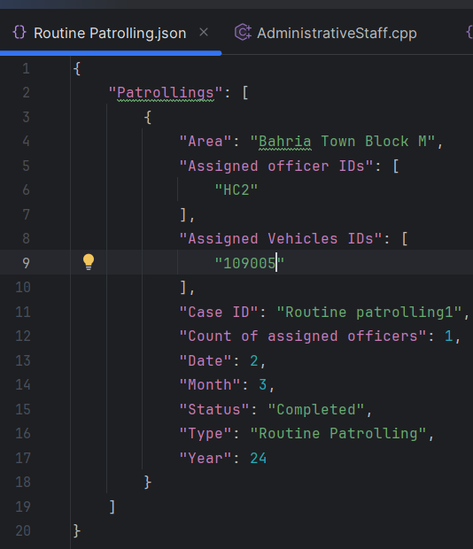
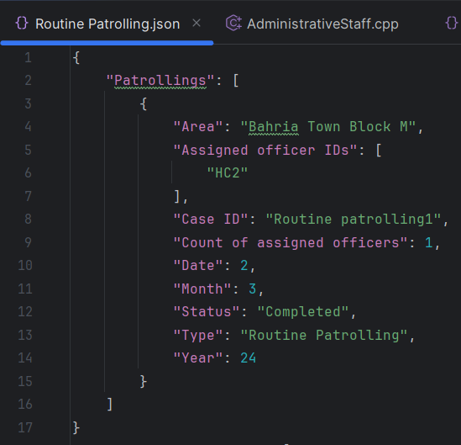
5
Administrative Staff

Slide 17
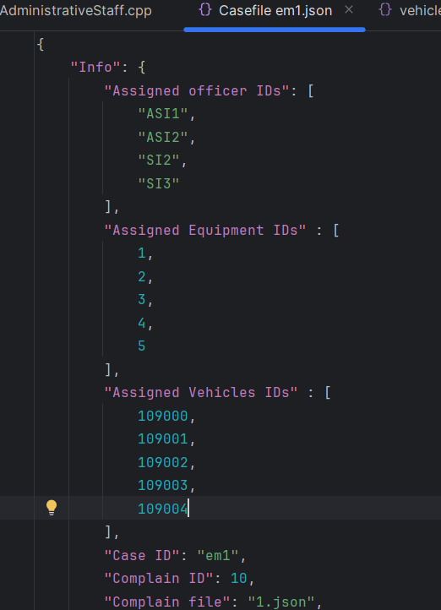
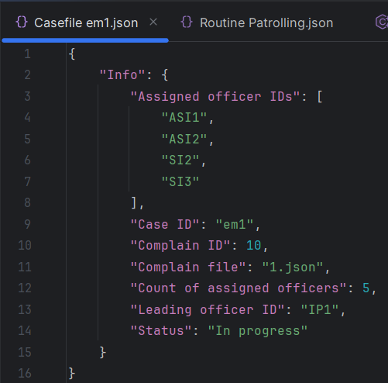
5
Administrative Staff

Slide 18
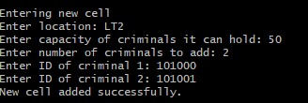
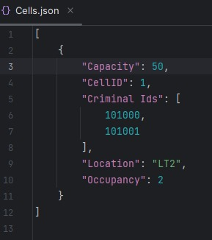
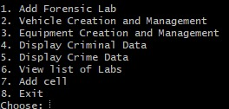
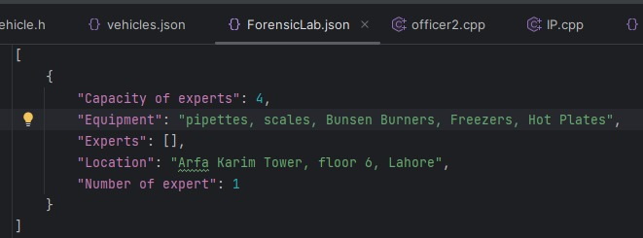
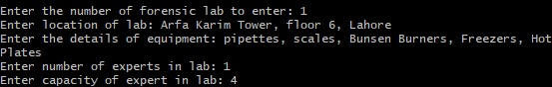
6
PoliceStation

Slide 19
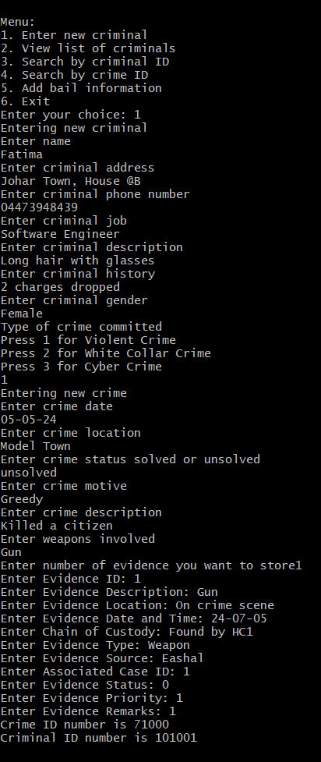


PoliceStation

Slide 20




PoliceStation

Slide 21



PoliceStation

Slide 22



Police Station

Slide 23




7
Head Constable

Slide 24


HeadConstable

Slide 25



Slide 26




Slide 27




8
Forensic Expert

Slide 28


Slide 29






9
Correctional Officer

Slide 30
Any questions??

